Slide 1
Covid-19 Impact on Vehicle Sales in 2020-2023 Stephanie Roethlisberger Dustin Sheets TJ Davis Juliana Cortes Arnold Vincent
The objective of this study is to analyze the impact of the COVID-19 pandemic on the SALES of used and new vehicles in the market from 2020 to 2023. We are looking at how the pandemic and its related economic effects influenced consumer behavior, vehicle demand, and market trends in the automotive industry during this period.
Notes:
Data exploration and cleanup
The data for this study was taken from various sources which are listed in the citations section of this presentation if you are interested.
The data for the next few slides was downloaded as excel files, converted to csv and read in for manipulation and cleanup.

Slide 2
Questions
How were vehicle sales affected between Jan 2020 and Dec 2022?
Why did prices increase?
Did gas prices affect vehicle sales?
How was global production affected by covid?
How did COVID impact Auto Financing?

Slide 3
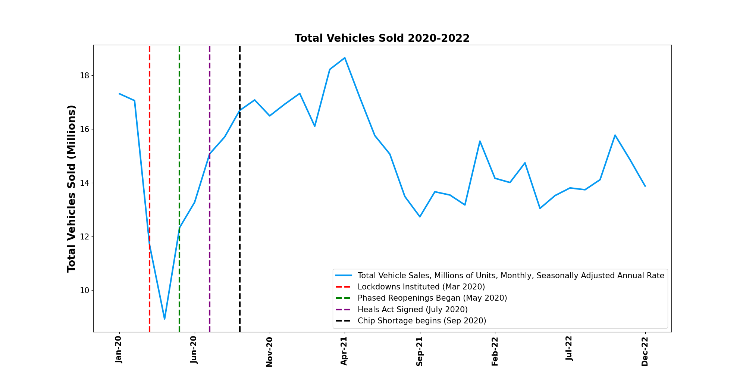
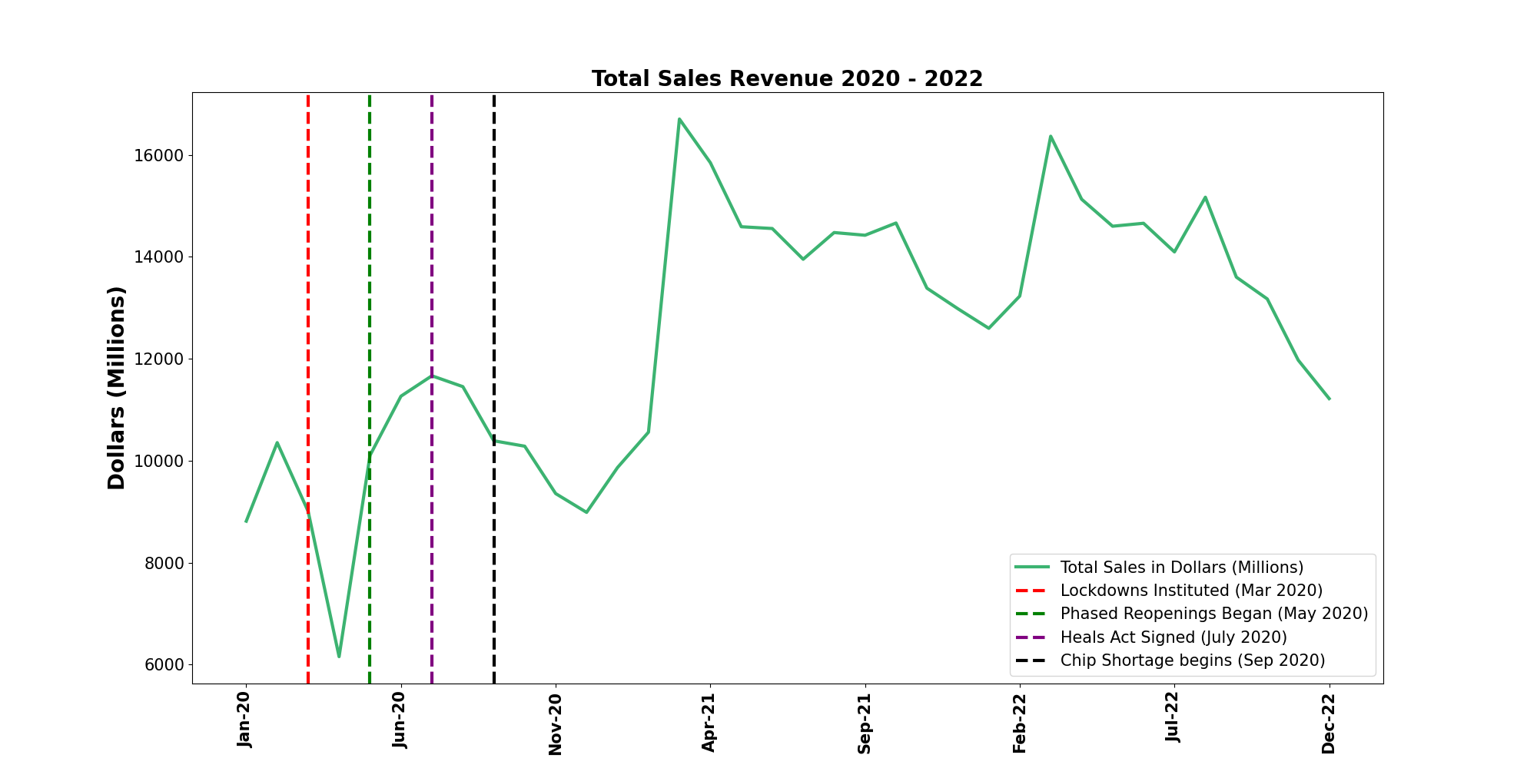
How were vehicle sales affected between Jan 2020 and Dec 2022?
Units sold declined 20%
Total Revenue rose 27%
Notes:
How were vehicle sales effected between Jan 2020 and Dec 2023?
You’ll see the horizontal lines mark some events that occurred during the pandemic that may have had an effect on sales volume.
Overall, you can see we saw a 20% decline in total units sold during this 3 year period.
Its interesting to note, that while total sales volume in the form of "units sold" had an initial drastic decline which happened at the beginning of the pandemic and once lockdowns where instated, it rebounded very rapidly back to pre-pandemic levels.
You also notice that starting in April of 2021, over a year since the pandemic began, the total number of units sold decreases, while the total revenue on those sales actually increased substantially.
In Nov of 2020 there were almost 17M units sold that generated about 9 billion dollars in revenue.
From Nov 2020 to April 2021, Units sold remained relatively stable and flat while revenue soared from 9 Billion to near 17 billion dollars on the same volume of cars sold.
So while total sales declined 20%....Total Revenue made actually rose by 27%. Why is that??

Slide 4
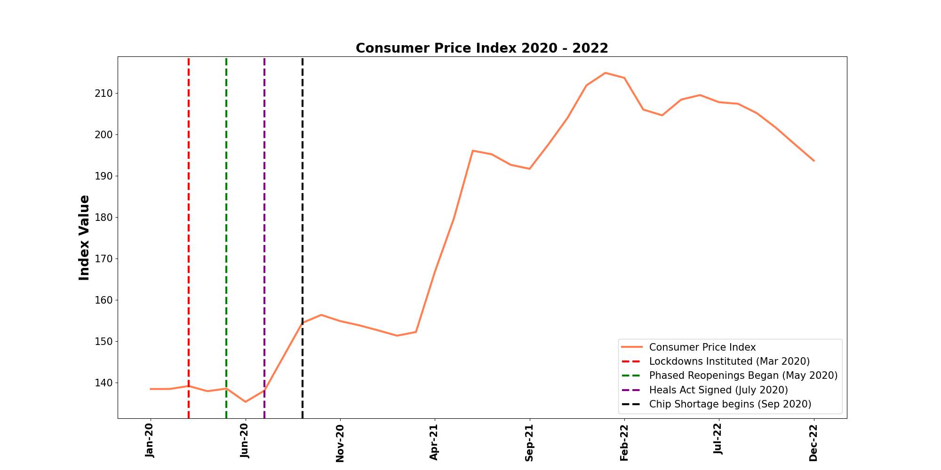
Were overall prices affected?
CPI rose 40%
Notes:
CPI INDEX:
Were prices or values different? The CPI index gives us an idea.
The Consumer Price Index is a measure of the average change over time in the prices paid by consumers for a market basket of consumer goods and services.
In English, it means: It measures weather or not cost of goods is going up or down.
Around this same time the CPI index rose dramatically, and dealer inventory levels fell off the map, which Dustin will show you shortly. Was this all due to Covid-19? That is difficult to say with 100% certainty as there are many variables at play. But I think you’ll see in the upcoming data that while Covid-19 itself may not have effected vehicle sales, the response to it in the form of regulations (Chip shortage) and stimulus checks (Cares and Heals Acts) played a key role in values and overall inflation soaring, as seen in the Consumer Price Index (CPI).

Slide 5
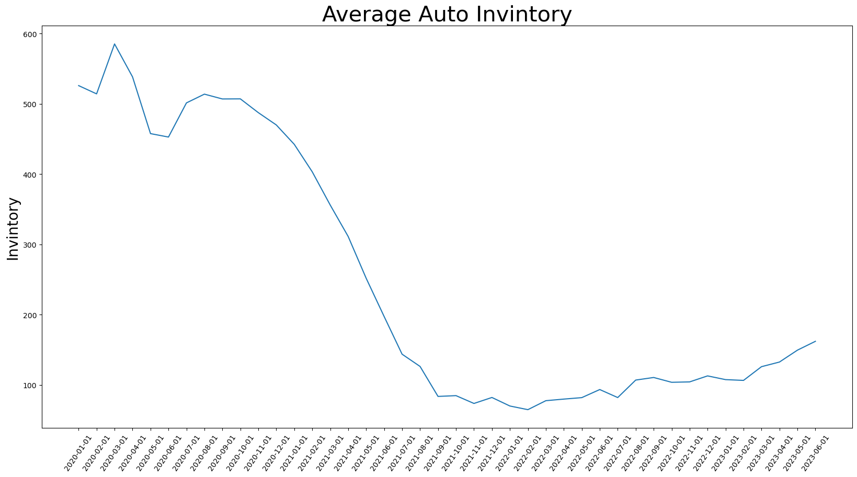
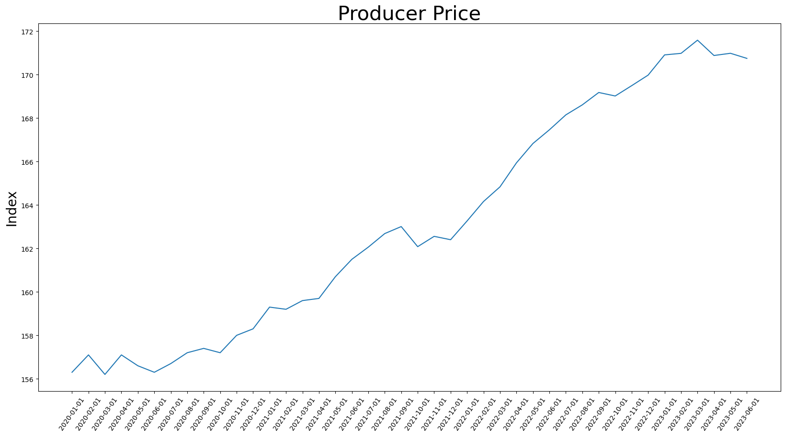
Why did prices increase?
I was able to find a -0.82 correlation between the producer price and the Inventory.

Slide 6
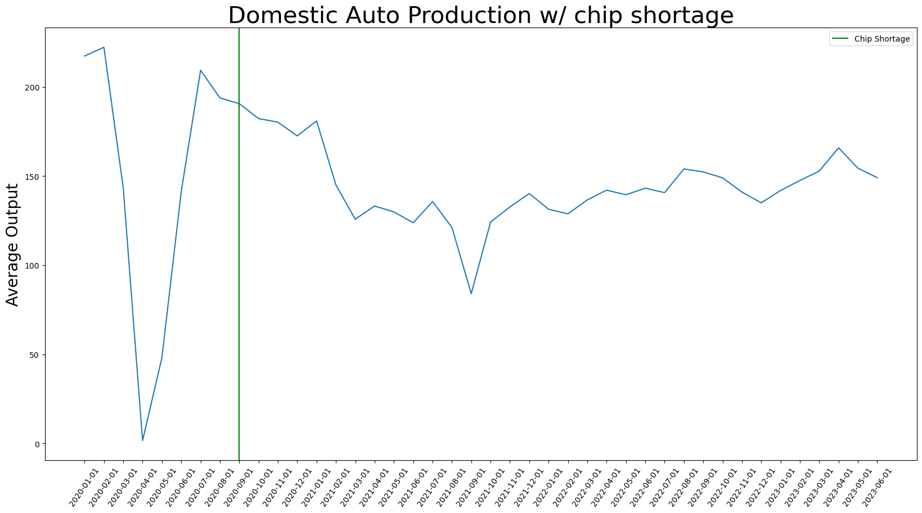
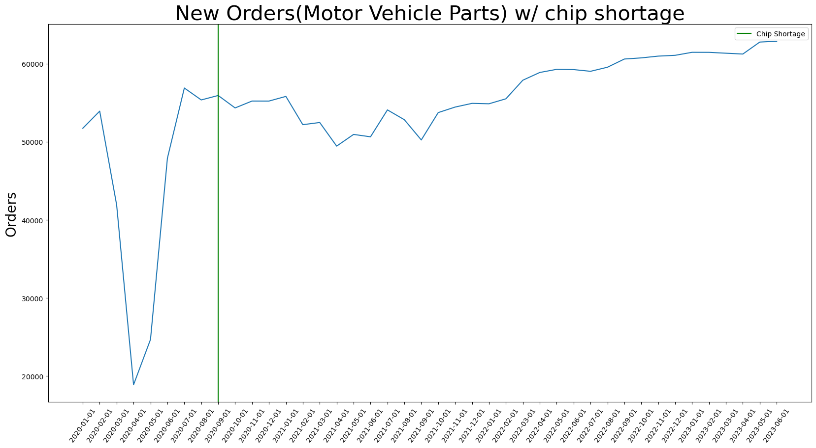
Less cars being made?

Slide 7
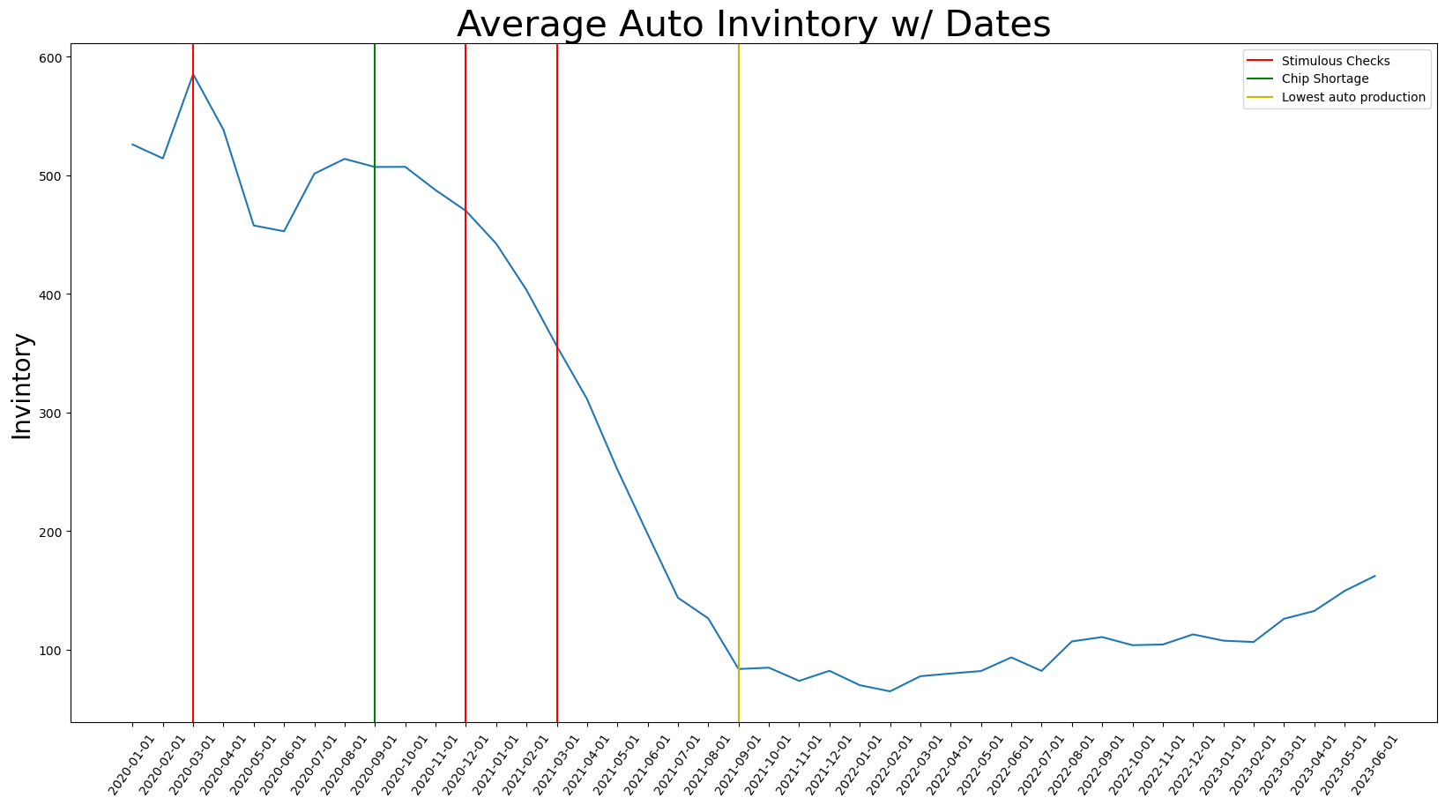
Why did prices increase?

Slide 8
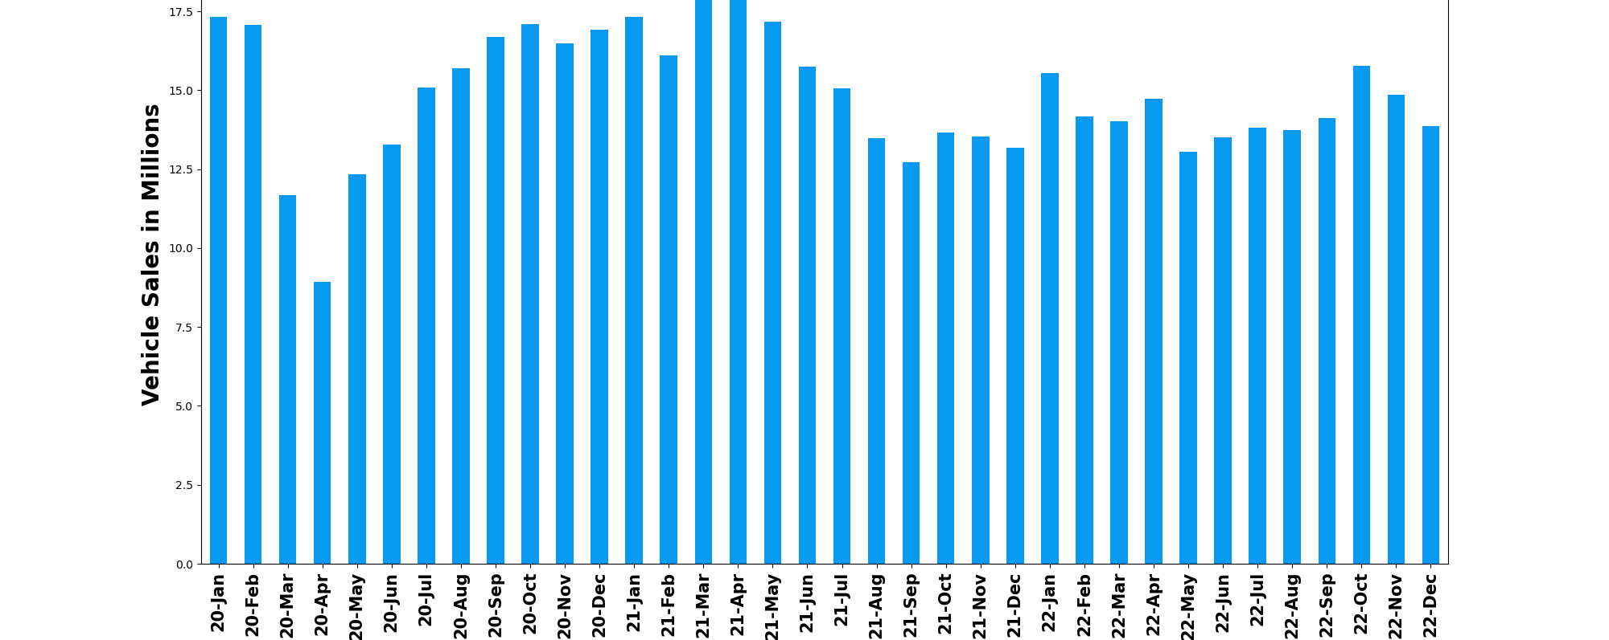
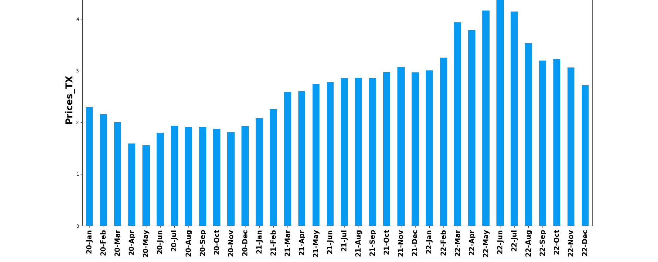
Did gas prices affect vehicle sales?

Slide 9
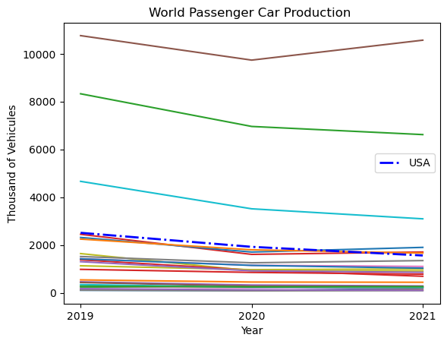
World Motor Vehicle Production

Slide 10
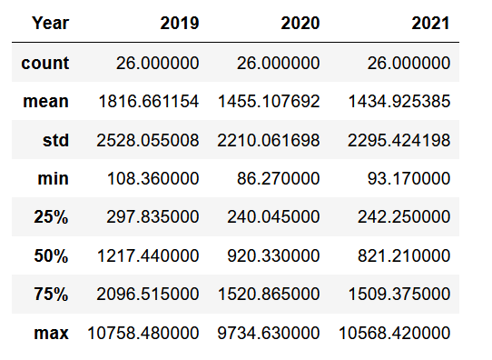
Statistic Resume World Car Production

Slide 11
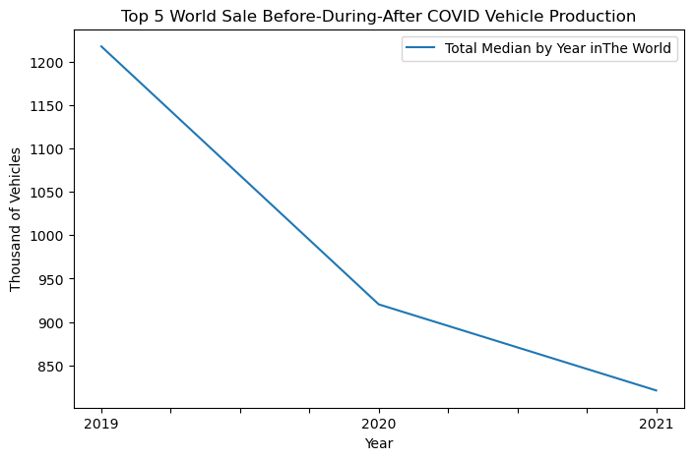

Slide 12
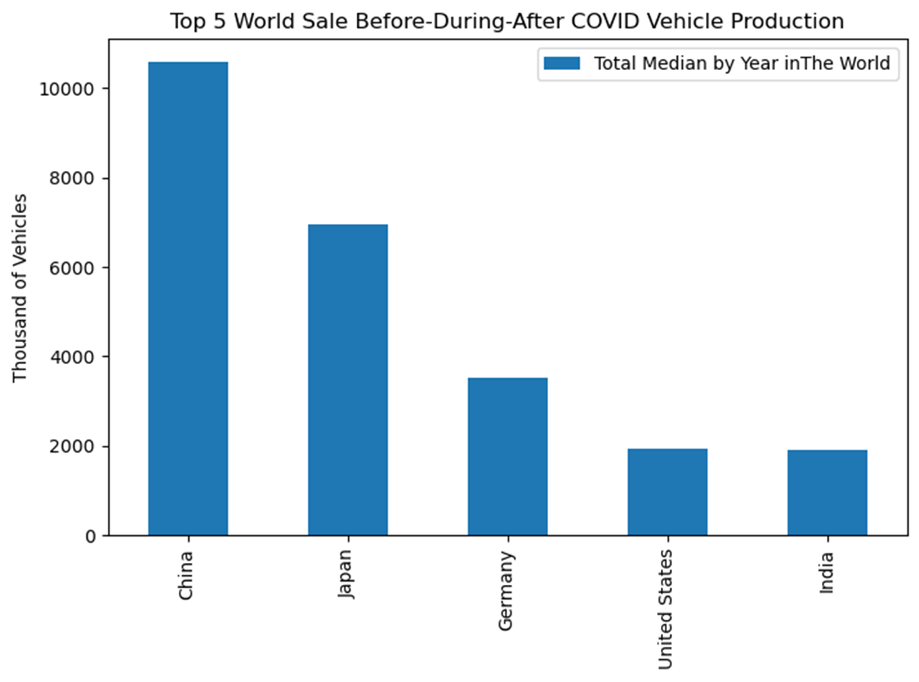

Slide 13
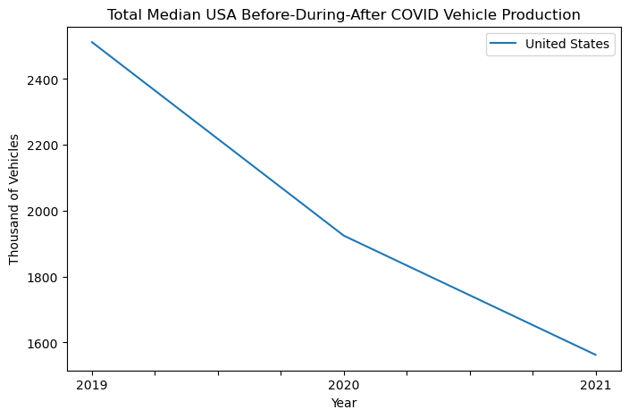

Slide 14
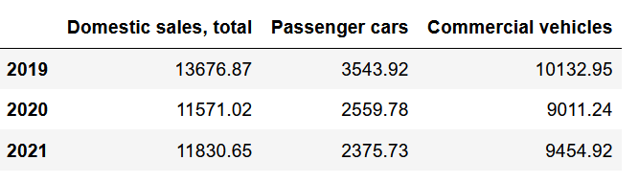
Annual Vehicle Production Sale USA

Slide 15
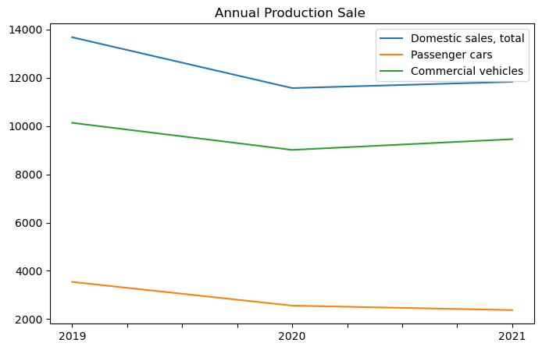

Slide 16
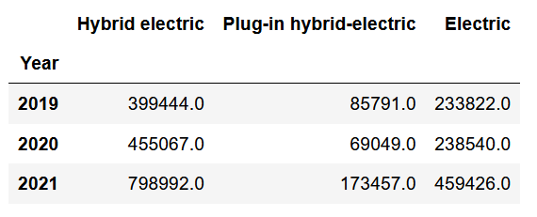
Electric Vehicle Sales

Slide 17
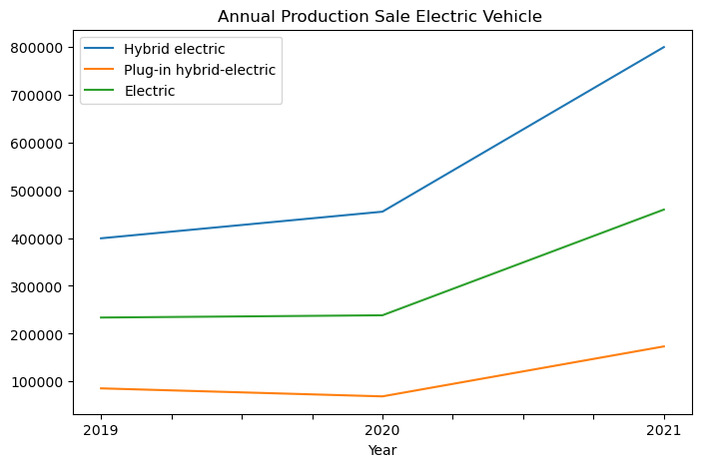
Comparison Total Vehicles
VS Electric Vehicles

Slide 18
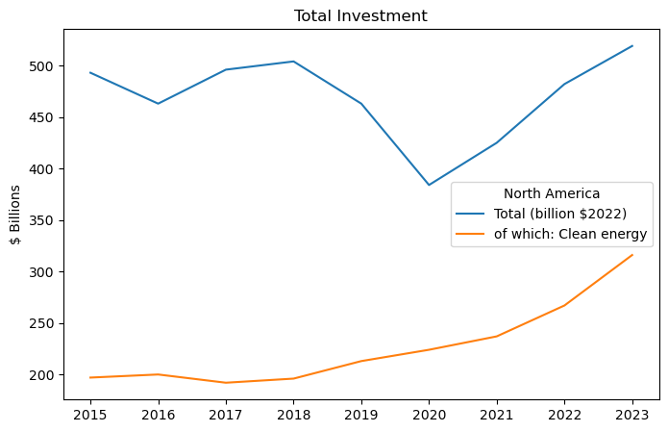

Slide 19
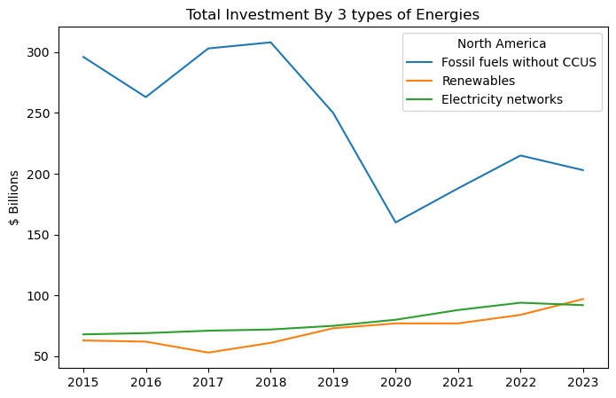

Slide 20
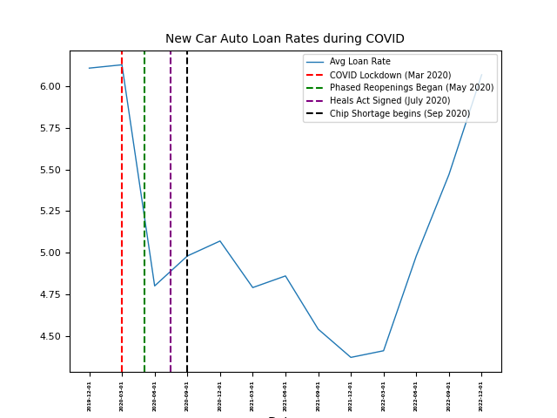
How did COVID impact Auto Financing?
Prior to Lockdowns the average New Car Auto Loan rate was approximately 6.11% (Q4 2019)
During the 1st Quarter of 2020 rates slightly rose to 6.13% (Jan 2020 – Mar 2020)
Lock Downs were instated March 2020
Easing Monetary Policy- March 15, 2020
The Fed Lowered the rate that it charges banks for loans by nearly 2%
Discount window was 90 days.
Q2 2020 rate: 4.80%
Q3 2020 rate: 4.98%
Notes:
Data Found:
https://www.federalreserve.gov/monetarypolicy/discountrate.htm
https://www.rpc.senate.gov/policy-papers/update-on-the-coronavirus-response-heals-act

Slide 21
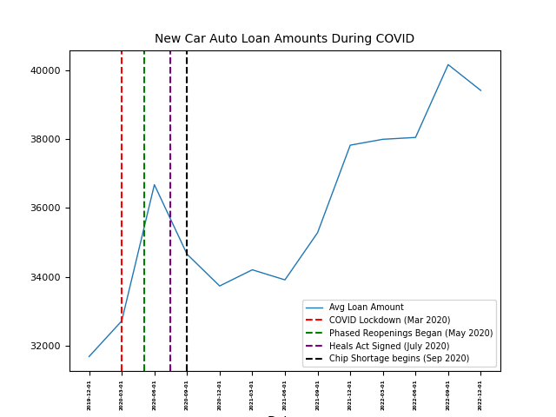
Auto Loan Rates vs Auto Loan Sizes
Notes:
Prior to Lockdowns the average New Car Auto Loan rate was approximately 6.11% (Q4 2019)
During the 1st Quarter of 2020 rates slightly rose to 6.13% (Jan 2020 – Mar 2020)
Easing Monetary Policy- March 15, 2020
The Fed Lowered the rate that it charges banks for loans by nearly 2%
Discount window was 90 days.
Q2 2020 rate: 4.80%
Q3 2020 rate: 4.98%

Slide 22
Auto Loan Rates vs Total Vehicles Sold
Notes:
*Q2 2020 when the Easing Monetary Policy was enacted and the Feds dropped rates significantly the Auto Market boomed and dealerships could not keep vehicles on their lots.
*Q1 2022 through Q4 2022 the Feds increased rates significantly and as a result you can see drop in auto sales.
*We can conclude that there is a definite correlation between Auto rates and the amount of vehicles sold during COVID

Slide 23
References
https://www.eia.gov/dnav/pet/pet_pri_gnd_a_epm0_pte_dpgal_m.htm
https://fred.stlouisfed.org/.
https://www.timeanddate.com/holidays/us/lockdown-day-1
https://www.nga.org/coronavirus-reopening-plans/
https://en.wikipedia.org/wiki/HEALS_Act
https://en.wikipedia.org/wiki/2020%E2%80%932023_global_chip_shortage#:~:text=In%20September%202020%2C%20as%20part,to%20companies%20with%20American%20ties.
https://www.federalreserve.gov/monetarypolicy/discountrate.htm
https://www.rpc.senate.gov/policy-papers/update-on-the-coronavirus-response-heals-act
https://www.timeanddate.com/holidays/us/lockdown-day-1
https://www.nga.org/coronavirus-reopening-plans/
https://en.wikipedia.org/wiki/HEALS_Act
https://en.wikipedia.org/wiki/2020%E2%80%932023_global_chip_shortage#:~:text=In%20September%202020%2C%20as%20part,to%20companies%20with%20American%20ties.

